Slide 1
Foundations for using generative AI
Brian Klaas ::: bklaas@jhu.edu
Notes:
Me: faculty member at JH Bloomberg SPH
Staying out of _how_ to use it, focusing on _thinking_ about how we can use these tools safely, effectively, and ethically.
Because while there’s a lot of promise in these tools, there's also a lot of potential for negative use of these tools

Slide 2
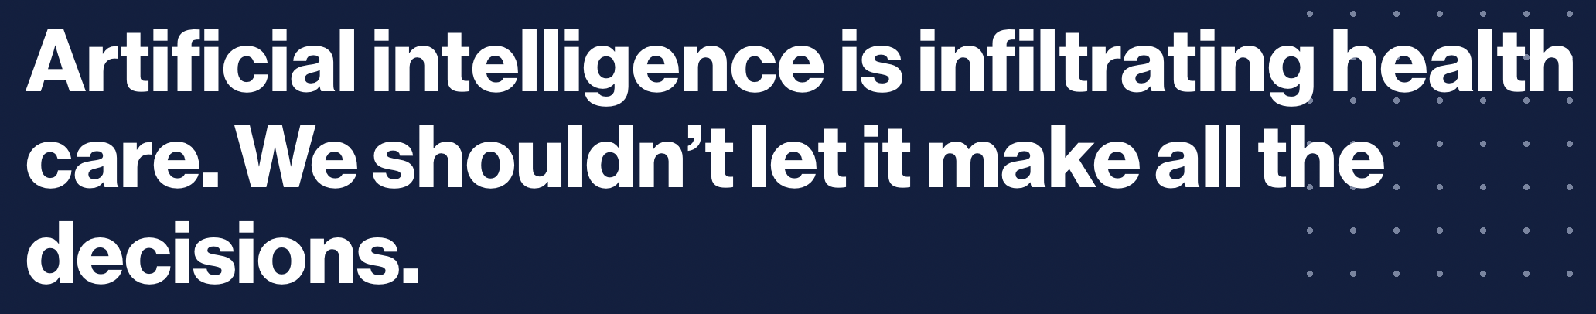
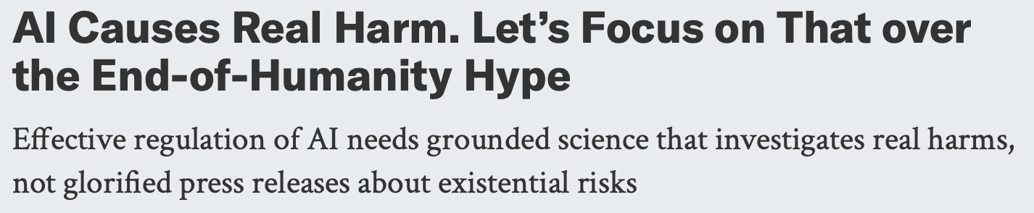
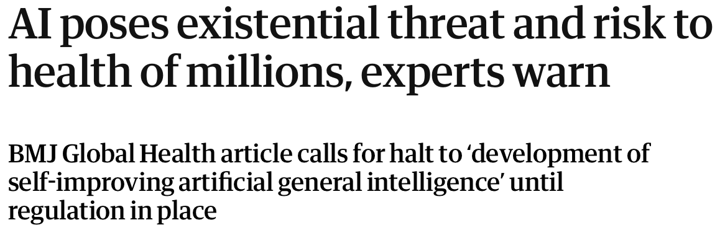
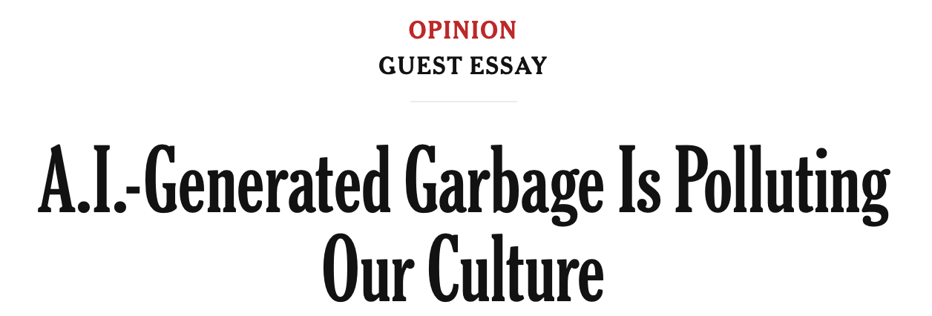
The Knife’s Edge
Notes:
There are serious concerns about the influence of generative AI on our healthcare, our well-being, and our culture as a whole. Do we want machine learning models making decisions about who gets medical care and treatment? Do we want generative AI taking notes for our physicians that may omit or obfuscate critical patient details? More generally: do the threats from generative AI outweigh the potential upsides? Because there are upsides.

Slide 3
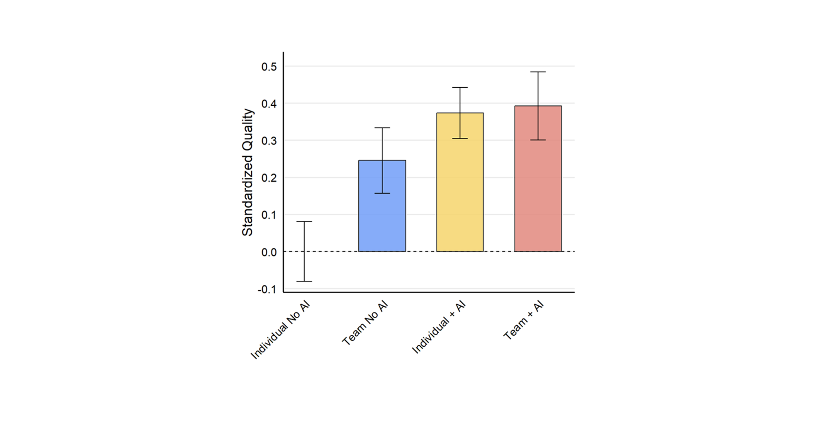
The Knife’s Edge
https://doi.org/10.21203/rs.3.rs-4243877/v1
Notes:
Study published in March, 2025 by Ethan Mollick and his colleagues at both Wharton and Harvard ; randomized controlled trial of 776 white collar professionals at Procter and Gamble
Individuals working with AI performed just as well as teams without AI
Teams using AI were significantly more likely to produce these top-tier solutions

Slide 4

The Knife’s Edge
ChatGPT, November 2024. “Create an image in the style of Russian propaganda from the 50's that depicts a woman walking along a very thin edge between the promise of a bright technological future and one where our lives are ruined by technology.”
Notes:
So for every potential advancement in using generative AI tools, there’s some equal measure of peril. My objective is that you leave this session today armed with a set of tools that will help you critically evaluate using and mitigating the risks of generative AI in your everyday public health work.

Slide 5

How generative ai works
Foundations for using generative AI
Notes:
high level overview, not a PhD-level approach
large language models that power tools like ChatGPT or Claude are actually based on a very simple statistical model.

Slide 6
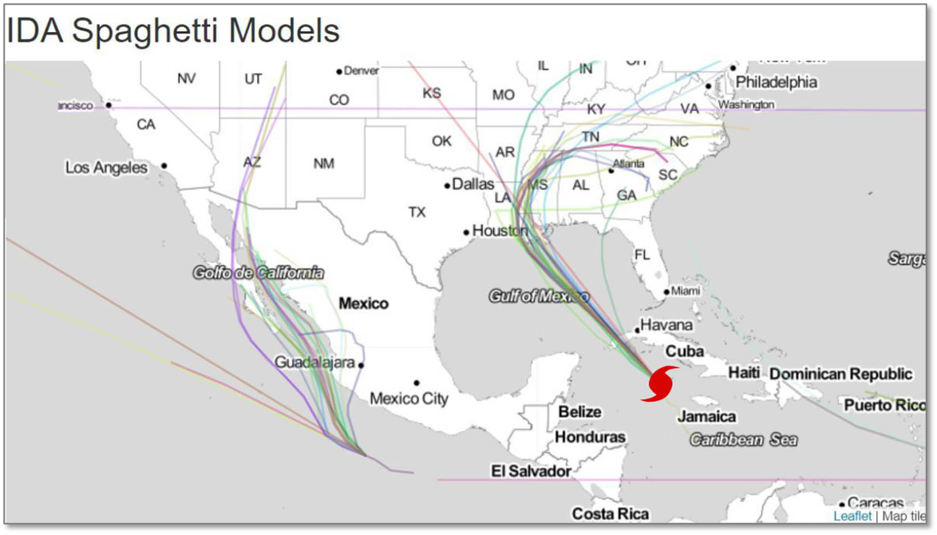
how generative ai works
https://science.howstuffworks.com/nature/climate-weather/storms/spaghetti-models.htm
Notes:
So you can think of ChatGPT or other large language models kind of like how meteorologists predict hurricane paths. Millions of pieces of data go into a system which predicts the path of a hurricane in real time. Now, this system isn't going to be 100% accurate all the time. But it's going to make its best guess as to where the hurricane is headed in the next 24 hours. It uses data to generate probabilities for the path of the hurricane.

Slide 7
A probability distribution over sequences of tokens
how generative ai works
Notes:
And that is exactly what large language models do. The classic definition in computer science of a language model is a probability distribution over a sequence of tokens or, more simply, words.

Slide 8
Vocabulary: $V$
Sequence of tokens: x1, … , xL
how generative ai works
Notes:
So let's say we have a vocabulary of words represented by the v here. And then we also have a sequence of tokens of individual words, word number one, word number two, word number three, word number four, word number five, and so on.

Slide 9
p(x1, … , xL)
how generative ai works
Notes:
And a language model represented here by p assigns each different sequence of tokens, each different sequence of words, a probability, a number between 0 and 1 that tells us, the users of this model, how, quote, good or accurate a sequence of words actually is. So let me give you an example.

Slide 10
$V$ = { ate, ball, cheese, mouse, the, green }
how generative ai works
https://stanford-cs324.github.io/winter2022/lectures/introduction/
Notes:
Let's say we have a vocabulary containing six words-- ate, ball, cheese, mouse, the, green. Then the language model assigns a specific probability to a specific sequence of each of these words in the vocabulary.

Slide 11
$V$ = { ate, ball, cheese, mouse, the, green }
p(mouse, the, the, cheese, ate)=0.0001
how generative ai works
https://stanford-cs324.github.io/winter2022/lectures/introduction/
Notes:
So the language model would say that the sequence "mouse, the, the, cheese, ate" has a very low probability score.

Slide 12
$V$ = { ate, ball, cheese, mouse, the, green }
p(the, cheese, ate, the, mouse)=0.01
how generative ai works
https://stanford-cs324.github.io/winter2022/lectures/introduction/
Notes:
And the language model would say that the sequence "the, cheese, ate, the, mouse" also has a pretty low probability score, although not as low as the last example.

Slide 13
$V$ = { ate, ball, cheese, mouse, the, green }
p(the, mouse, ate, the, cheese)=0.7
how generative ai works
https://stanford-cs324.github.io/winter2022/lectures/introduction/
Notes:
The model would assign a much higher probability to the sequence of words "the, mouse, ate, the, cheese." So why would it assign that particular sequence a much higher probability? They're just words, right? Well, the model itself has code, algorithms that evaluate both the syntactic probability of a sequence of words as well as a world knowledge about how those words are used in the real world. And it gets both of these things from its training data from the trillions of pieces of text that it processes when the model is being trained. It also gets some foundational knowledge about how the English language works, in this case, from the decades of research and commercial deployment of dictation software, like Siri or Dragon NaturallySpeaking.

Slide 14
$V$= { ate, ball, cheese, mouse, the, green }
p(mouse, the, the, cheese, ate)=0.0001
how generative ai works
Low syntactic probability
https://stanford-cs324.github.io/winter2022/lectures/introduction/
Notes:
So the sequence "mouse, the, the, cheese, ate" gets a very low syntactic probability score because the algorithms inside the model say, this is not how these words go together in the English language.

Slide 15
$V$= { ate, ball, cheese, mouse, the, green }
p(the, cheese, ate, the, mouse)=0.01
how generative ai works
Low World Knowledge probability
https://stanford-cs324.github.io/winter2022/lectures/introduction/
Notes:
The sequence "the, cheese, ate, the, mouse" also gets a fairly low probability because the world knowledge that the model has gained through its training also says, uh uh, cheese doesn't eat mice. Mice eat cheese.

Slide 16
$V$= { ate, ball, cheese, mouse, the, green }
p(the, mouse, ate, the, cheese)=0.7
how generative ai works
Good Syntactic and World Knowledge probability
https://stanford-cs324.github.io/winter2022/lectures/introduction/
Notes:
But the sequence "the, mouse, ate, the, cheese" gets a much higher probability because, during its training, the model has learned that this sequence has both good syntactic probability and world knowledge probability. So if someone were to type in the words "the, mouse," into a tool like ChatGPT, the large language model would probably guess "ate the cheese" as being the next couple of words because that particular sequence of words has a much higher probability than other sequences of the same words.

Slide 17
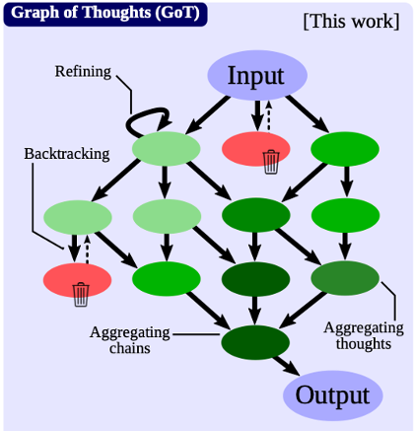
how generative ai works
Prompt
Is it done?
Use
a tool
Ask for
clarification
Notes:
Behind the scenes, things are _vastly_ more complicated, using multiple tree of thought processes in a loop

Slide 18
p(x1, … , xL)
how generative ai works
Notes:
But it all still boils down to this simple probability. That's how tools like ChatGPT or Claude or Google Gemini work at their core. And remember, these are probabilities, not certainties. These are predictions, not facts.

Slide 19

pop Quiz
Foundations for using generative AI
Notes:
How does a large language model (LLM) like ChatGPT predict the next word in a sentence?
A) By using a fixed set of rules
B) By calculating the probability of word sequences
C) By randomly selecting words
D) By following a preset narrative
Correct Answer: B) By calculating the probability of word sequences
TF: Asking generative AI the same question multiple times will give you the exact same answer each time. (F)
What is a fundamental characteristic of how generative AI operates?
A) They use deterministic algorithms to ensure accuracy.
B) They require manual input for image details.
C) They predict and refine outputs based on trained data.
D) They only use text data for image generation.
Correct Answer: C) They predict and refine outputs based on trained data

Slide 20
Pop QUiz
How does a large language model (LLM) like ChatGPT predict the next word in a sentence?
A) By using a fixed set of rules
B) By calculating the probability of word sequences
C) By randomly selecting words
D) By following a preset narrative
Notes:
Correct Answer: B) By calculating the probability of word sequences

Slide 21
Pop QUiz
True/False: Asking generative AI the same question multiple times will give you the exact same answer each time.
Notes:
FALSE

Slide 22
Genai governance
Foundations for using generative AI
Notes:
Now that we understand how these prediction engines work, let’s shift to thinking about how we and our teams can use them in a considered, responsible way, and that starts with developing governance.

Slide 23
It’s not if you need to deal with this.
governance
You need to deal with this.
Notes:
Because it’s not a question of “if” you need to deal with generative AI use in the workplace. [click] You need to deal with this.
You cannot secure what you do not govern. You cannot close vulnerabilities you don't know exist. And you cannot know what exists if nobody in your organization has been given the authority to find out. Governance is the apparatus that makes every other thing we talk about today actually work.

Slide 24
Who decides.
Who's accountable.
How it holds up over time.
governance
Notes:
And governance is really about three things: Who decides. Who's accountable. How this holds up over time — especially in a small department with limited staff.

Slide 25
Right now, somebody is deciding.
governance
Do you know who?
Notes:
Right now, in an office in one of your health departments, somebody is pasting something into ChatGPT. They are making a judgment call, in real time, about what's okay to send to that tool and what isn't. [click]
Governance is what turns "somebody" into a named, accountable, reviewable structure. If you can't tell me who in your department is making those calls, you don't have governance. You have hope. And hope is not a plan when dealing with these very sophisticated prediction machines.
Let me show you what happens when hope is the plan.

Slide 26
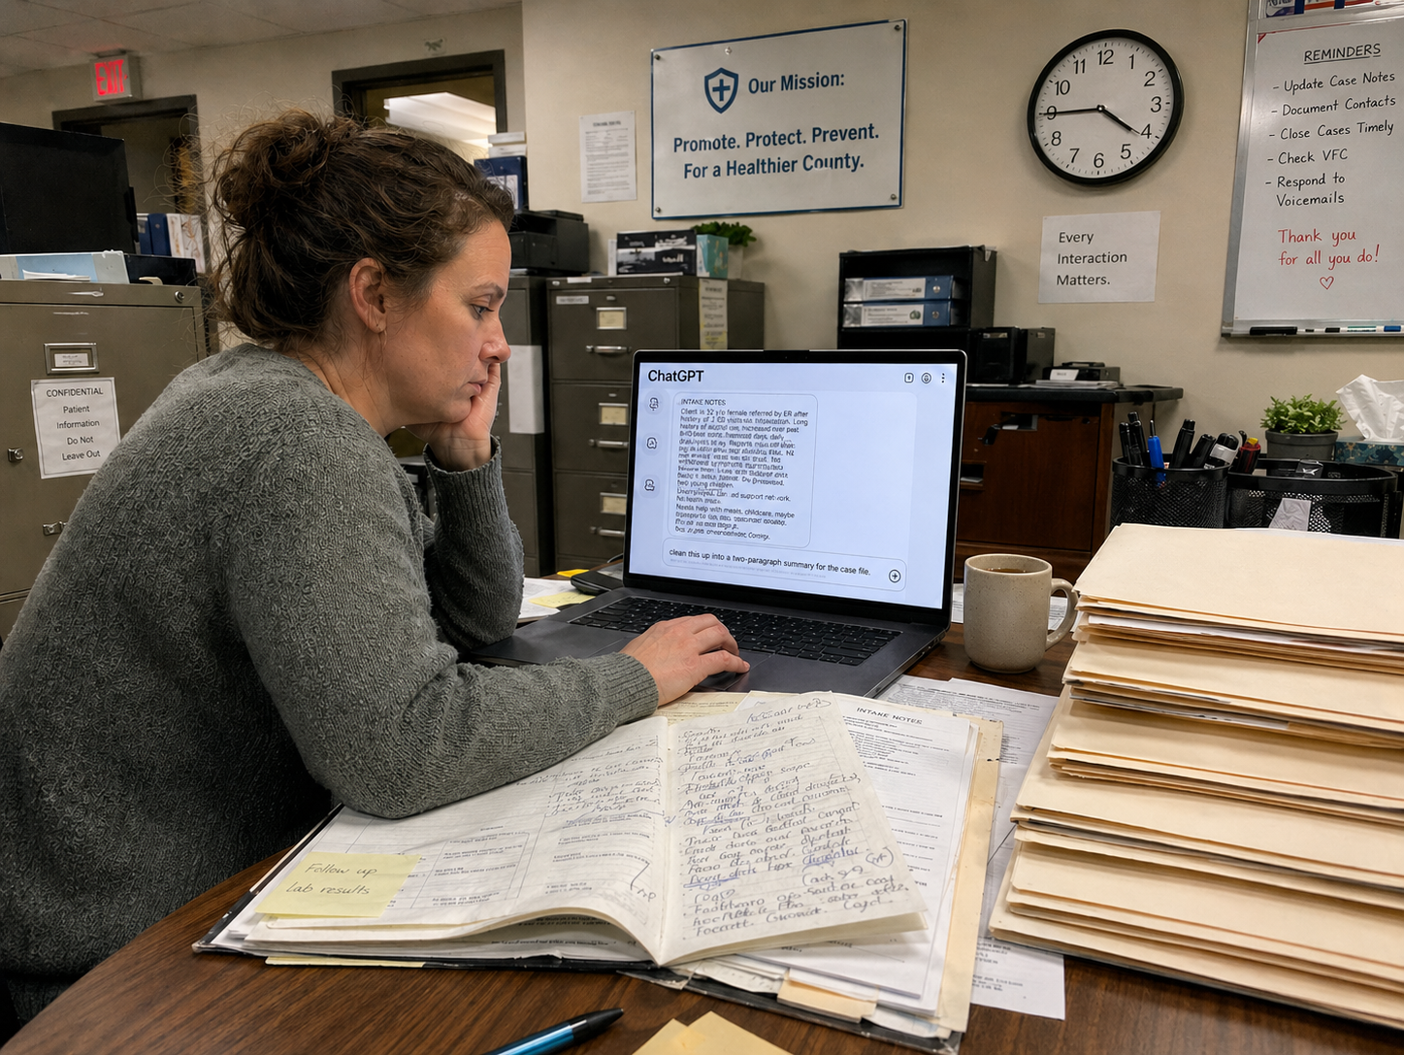
governance
ChatGPT, April 2026. “Make an image of this scene: It's Friday afternoon, 4:45. An intake coordinator at a county health department has six case files to close before the weekend. She is tired and the week has been long...”
Notes:
I want to walk you through a scenario. This is not hypothetical. Some version of this is happening in public health departments right now, including — probably — by teams represented in this audience.
It's Friday afternoon, 4:45. An intake coordinator at a county health department has six case files to finish up before the weekend. One of them is messy — a new client, a difficult intake conversation, the notes are half-typed and half-scrawled. She opens ChatGPT on her work laptop. She pastes in the intake notes. She types: "clean this up into a two-paragraph summary for the case file."
She is not being reckless. She's being efficient. These tools are genuinely good at this. She gets a summary back. She pastes it into the case record. She goes home.
Monday morning. The case file gets routed through normal workflow. A supervisor glances at it. It reads fine. It goes into the system. Nobody notices that a generative AI tool wrote most of it.
On Thursday, the client calls the department. She's upset. She says the summary in her file mentions that she "struggles with housing instability related to a recent separation." She never said that. She had said something similar — that her living situation was stressful — and the AI, trying to be helpful, filled in the gap with something plausible, but something it made up.
At your next department board meeting, a board member who reads the local paper has seen that a client is now filing a complaint. She asks the commissioner a very simple question: Who approved the use of AI with client intake data?
And the honest answer is in many situations: nobody.
Not because anybody did anything wrong. Not because anybody was careless. But because nobody was accountable. No one had been told, this is your decision to make. No inventory existed of what tools were being used. No review happened before something went out the door.
That is what a governance gap looks like. And the fix for it is not a better policy document, although you will absolutely need one of those. The fix is somebody named whose job it is to see that scenario coming and put controls in place before it happens. That's where governance starts.

Slide 27
Raise your hand in Zoom and keep it raised.
governance
Notes:
OK, I want to do a quick follow-on exercise to this story. Please click the “Raise Hand” button in Zoom and leave your hand raised until the end of this exercise.

Slide 28
Keep your hand up if:
governance
1
Your staff are already using consumer AI tools.
2
A vendor has pitched you an AI-powered product in the last twelve months.
3
You cannot name — right now — who decides if a new AI tool gets used.
4
You do not have a written record of any AI decision made in the last year.
Notes:
Keep your hands up if [read all four]
NOW, Keep your hand up only if ALL FOUR are true.
That’s a lot of hands
That is what a governance gap looks like in your own department. Same gap as the one in the scenario. And the thing I want you to take away from this moment is: the only reason that scenario hasn’t happened to your department yet is luck. Luck is not a governance strategy. Let me show you what is.

Slide 29
NIST AI Risk Management Framework
governance
GOVERN
Who decides?
MAP
What do we have?
MEASURE
Is it working?
MANAGE
What happens
when it fails?
https://www.nist.gov/itl/ai-risk-management-framework
Notes:
So if you go do a quick Google search for an approved AI governance framework, you’ll probably get routed to the National Institute of Standards and Technology (or NIST)'s AI Risk Management Framework. This is a commonly adopted framework in many federal organizations. And it focuses on four core functions: Govern. Map. Measure. Manage.
You'll see these four words a lot if you read anything about AI governance over the next year. They usually get presented this way — four equal boxes, four equal functions, like four legs of a stool.
Govern: who decides. Map: what we have. Measure: is it working. Manage: what we do when it fails.
Four equal pieces, right?
But here's the problem with that picture. It's wrong. And if you build your department's AI work on this picture, you will fail in a specific and predictable way.

Slide 30
Governance is the foundation.
governance
MAP
Depends on governance.
MEASURE
Depends on governance.
MANAGE
Depends on governance.
GOVERN
Who decides?
Named roles. A body that signs off.
Escalation when things get hard.
Regular reviews.
Notes:
Because here's what the picture actually looks like.
Govern isn't one of four equal functions. It's the foundation. Everything else — mapping your tools, measuring whether they work, managing what happens when they fail — every one of those only exists because somebody was given the authority to do it, somebody was held accountable for whether it got done, and somebody reviewed whether it was still working.
If you don't have governance, you don't get mapping. You get a Word document someone made once and then forgot about. You don't get measurement. You get vibes. You don't get incident management. You get blame.
For public health professionals, governance comes down to four concrete things. 1. Named roles — not ”it should probably look like this," but instead a specific person whose job includes AI oversight. 2. A body that signs off — and by body I mean two or three people with a calendar invite, not neccesarily a formal committee with bylaws. 3. Escalation when things get hard — a clear line for what comes up the chain and what gets handled in place. And 4. a regular review of policy that you actually perform because the AI landscape in May of 2027 will look a lot different than it does today.
My co-presenter Tatiana Lin will walk you through what a policy document that governance produces might look like. What I want you to hold onto is: if you get the governance right, the policy writes itself. If you get it wrong, the policy is a piece of paper nobody follows _and_ nobody is accountable when something goes wrong, and that's even more important when we talk about security, which we will discuss in just a few minutes.

Slide 31
Two questions, in this order:
governance
Capability
Capacity
Do we know what we have?
Do we have the people?
Who chairs the governance body?
Who reviews AI outputs before they go public?
Who handles an incident at 9 PM on a Tuesday?
What tools are we actually using?
Which vendors added AI to our tools?
Who can evaluate a contract with AI–enabled tools?
Notes:
Before you build any governance structure, ask these two questions about your department or workgroup. Small departments often skip this step and then build a governance body that can't actually function.
First, Capability. Do we know what we have? What tools are we actually using right now — not what has been officially authorized, what people are actually using? Which vendors in your stack just added AI features last quarter without telling you? And do we have someone — contract IT, a regional partner, the neighboring county's CIO — who can look at a contract involving AI and tell you whether it's safe?
Then, Capacity. Do we have the people? Who chairs this governance body? Who reviews AI outputs before something goes out under your department's letterhead? Who handles an incident at 9 PM on a Tuesday?
If the honest answer to any of these is "I don't know" — that’s OK! That is now your first governance decision.
And for rural counties, where I know resources and especially personnel can be constrained, you do have a real option: share capability across counties. A joint AI governance body covering multi-county districts, or a memorandum of understanding with the county next door on incident response. are both are legitimate and both can work without everyone having to hire new people.

Slide 32
Five pieces of effective governance
governance
A named oversight body
A chair
An escalation path
A review cadence
A decision record
1
2
3
4
5
Notes:
There are the five pieces of a functioning governance structure. And because I know that not every county in Ohio is the same size, has the same population, or has the same resources, I want to give you ways of thinking about implementing this for both more urban and more rural counties.

Slide 33
Five pieces of effective governance
governance
 | More Urban | More Rural
A named oversight body | AI committee with 5–7 members across IT, legal, programs, and leadership. | Two or three people with other jobs, meeting monthly.
A chair
An escalation path
A review cadence
A decision record
1
2
3
4
5
Notes:
First — a named oversight body. In a county with more resources, this means a real AI committee, five to seven members across IT, legal, programs, and leadership. In a county with less resources, this means two or three people with other jobs, meeting monthly. In a health department with fourteen staff, in a county of 24,000 people, an "AI committee" can be the deputy commissioner, the person who runs environmental health, and their contract IT vendor. They meet on the first Tuesday of each month for forty-five minutes. That is a legitimate governance body. The word "committee" is not the point. The word "named" is the point.

Slide 34
Five pieces of effective governance
governance
 | More Urban | More Rural
A named oversight body | AI committee with 5–7 members across IT, legal, programs, and leadership. | Two or three people with other jobs, meeting monthly.
A chair | Dedicated role — often a Deputy Commissioner or Chief Information Officer. | You, or your deputy. One person with the authority.
An escalation path
A review cadence
A decision record
1
2
3
4
5
Notes:
Second — a chair. In a larger county with more resources, this should be a dedicated role, often deputy commissioner or CIO. In a more rural county, this can be anyone in management really. They have authority to pause any AI use, approve any new AI tool, and call an emergency review. Having one decision maker is a good thing because when things get hard, people know who to call.

Slide 35
Five pieces of effective governance
governance
 | More Urban | More Rural
A named oversight body | AI committee with 5–7 members across IT, legal, programs, and leadership. | Two or three people with other jobs, meeting monthly.
A chair | Dedicated role — often a Deputy Commissioner or Chief Information Officer. | You, or your deputy. One person with the authority.
An escalation path | Tiered — staff handles routine, body reviews new tools, commissioner approves high-risk. | Simpler — "if PHI or public-facing, it comes to the chair."
A review cadence
A decision record
1
2
3
4
5
Notes:
Third — an escalation path. In a more urban setting with more staff, you would have tiers of escalation. Routine stuff handled by staff, new tools reviewed by the governance body, high-risk decisions approved by the commissioner. In a rural department, escalation might be summed up in one sentence: "if it's personal health information or PHI or public-facing, it comes to the governance chair." That's the whole escalation policy. One rule, and very staff member knows it.

Slide 36
Five pieces of effective governance
governance
 | More Urban | More Rural
A named oversight body | AI committee with 5–7 members across IT, legal, programs, and leadership. | Two or three people with other jobs, meeting monthly.
A chair | Dedicated role — often a Deputy Commissioner or Chief Information Officer. | You, or your deputy. One person with the authority.
An escalation path | Tiered — staff handles routine, body reviews new tools, commissioner approves high-risk. | Simpler — "if PHI or public-facing, it comes to the chair."
A review cadence | Quarterly meetings, annual full policy review. | Annual review, plus a trigger: any new AI vendor contract.
A decision record
1
2
3
4
5
Notes:
Fourth — a review cadence. Quarterly meetings and annual review if you're bigger. Annual review plus a trigger about new vendors if you're smaller. The trigger matters because you don't want a vendor who renews a contract and slipping AI into the renewal without flagging it. If your only review is annual, you miss it. If your review trigger is "any new or renewed AI-involved contract," you're going to catch it.

Slide 37
Five pieces of effective governance
governance
 | More Urban | More Rural
A named oversight body | AI committee with 5–7 members across IT, legal, programs, and leadership. | Two or three people with other jobs, meeting monthly.
A chair | Dedicated role — often a Deputy Commissioner or Chief Information Officer. | You, or your deputy. One person with the authority.
An escalation path | Tiered — staff handles routine, body reviews new tools, commissioner approves high-risk. | Simpler — "if PHI or public-facing, it comes to the chair."
A review cadence | Quarterly meetings, annual full policy review. | Annual review, plus a trigger: any new AI vendor contract.
A decision record | Minutes, decision log, inventory of approved and rejected tools. | A shared document. One line per decision. Date, tool, decision, who.
1
2
3
4
5
Notes:
Fifth — a decision record. This is the one that so many departments skip, and it's the one that matters most for security. When you have more resources, you can have formal minutes, a decision log, an inventory of approved and rejected tools. In a smaller department, you can have a shared spreadsheet with one line per decision — date, tool, decision, and who made that decision. That's enough.
What you cannot do is have no record. Because the day something goes wrong, and your board or an executive or a state-level deputy asks the question "who approved this?" — which is exactly the question that got asked in the scenario I opened with — you need to be able to answer it. A spreadsheet answers it. Hope does not.

Slide 38
Your first step toward governance:
governance
4
people
1
hour
1
question
Notes:
So this week — this week — you can take the first move toward having real AI governance.
You need four people to take one hour to answer one question. Who decides what, and where is it written down? Answer that question, and you have the beginnings of real governance.

Slide 39
Governance matters because
governance
generative AI changes what you’re protecting.
Notes:
Governance matters because when it comes to security and vulnerability, generative AI changes what you're protecting.
Before generative AI, the things you had to secure were the things you recognized: servers. Files. Email. Known attack surfaces. And governance meant securing known assets.
Generative AI introduces new categories of things to protect — things most of your existing policies weren't written for. Data you didn't realize was flowing out of your department, because an employee copied it into a prompt. Outputs that look authoritative but contain fabricated information. Vendors whose systems are now opaque to you because their AI components came from somewhere else.
You cannot secure what you do not govern. And you cannot govern what you do not know exists.

Slide 40
Genai security
Foundations for using generative AI
Notes:
Which is exactly what I want to talk about next — what generative AI actually looks like from a security perspective, where the new vulnerabilities are, and what you can actually do about them.

Slide 41
Every AI security question sits behind one of these doors:
security
1
Data going out.
2
What comes back in.
3
The one you
didn’t know existed.
Information leaving your department,
through staff, into AI tools
you don't control.
Information returning that looks right,
sounds authoritative,
but may not be true.
AI your vendors added
to software you already use,
without telling you.
Notes:
So almost every AI security question sits behind one of three doors.
Before generative AI, the things you had to secure were the things we all knew about from decades of IT deployment and work experience. And governance meant securing those known assets.
Generative AI introduces three categories of risk that most existing security policies were never written for. Three doors, as it were, into your department.
Door one — data going out. Information leaving your department, usually through staff, going into AI tools you don't control.
Door two — what comes back in. Information returning from AI tools that looks right, sounds authoritative, and may not be true. These are very sophisticated prediction engines, after all.
Door three — the door you didn't know existed. AI your vendors added to software you already use, without you approving it or even knowing about it.
Now I need to make clear that traditional IT security — firewalls, password hygiene, phishing training — still matters. Every county health department already has some version of that. That's not what we're talking about today. These three doors sit ON TOP of the old security model. They're new.
And the reason the three-doors framework matters is this: every AI security question you'll face for the foreseeable future sits behind one of these three doors. If you can figure out which door a situation belongs to, you know what kind of control applies, which makes making decisions much easier.
Let me share with you a couple of stories to help understand how these doors work in practice.

Slide 42
Samsung
security
1
Data going out.
Information leaving your department,
through staff, into AI tools
you don't control.
https://www.forbes.com/sites/siladityaray/2023/05/02/samsung-bans-chatgpt-and-other-chatbots-for-employees-after-sensitive-code-leak/
Notes:
Let's start with door one. Data going out.
You already saw a version of this in the governance segment. Friday afternoon, 4:45. Intake coordinator pastes client notes into ChatGPT to clean up a summary. That was a governance failure — nobody had been named to approve that workflow. It was also door one. Data going out of your department, into a tool you don't control, and once it's in, it doesn't come back.
Here's what this looks like on a larger scale.
In March 2023, the Samsung corporation had a ban on using generative AI tools in place. But then the semiconductor division lifted its ban on ChatGPT. The company wanted engineers to move faster because that was the big promise of generative AI tools. Within twenty days, three separate engineers pasted confidential company data into ChatGPT. One pasted proprietary source code from a semiconductor database, looking for help with a bug. Another recorded a company meeting and asked ChatGPT to produce minutes from that recording. A third pasted code for identifying defective chips, asking for optimization of that code. Because there was no governance on either Samsung's side OR ChatGPT's side, all of that content is now part of OpenAI's training data. And, of course, Samsung reinstated the company-wide generative AI ban within weeks.
And I want you to understand something about those engineers. They were not reckless. They were not disgruntled. They were trying to do their jobs well with a tool that genuinely helped them work faster. That is exactly the situation inside every health department in Ohio, or every college in this country, or every federal agency. Just replace source code with case notes. Replace meeting recordings with community health assessment interviews. Replace defect optimization code with grant application drafts. The story is identical.
This story also raises a very important point. Without legal agreements in place with providers, without governance that ensures those legal agreements are followed, data you put into a public AI tool does not come back. There is no retrieval. No deletion. You can't call OpenAI and ask them to unsend a prompt. It is not like a mis-sent email. Once it is in, it is in — sometimes permanently in the model's training data, sometimes in the vendor's logs, sometimes both. That finality is what makes door one different from a normal IT mistake.
And here's a little wrinkle specific to Ohio. Under Ohio public records law, those prompts your staff typed into ChatGPT may themselves be public records. A resident can file a records request for "all AI interactions involving my case file" — and your department may be legally required to produce them. Think about that. The prompt your intake coordinator typed on Friday afternoon may be discoverable, which means door one isn't just a security problem, it's a legal exposure you may not have factored in.

Slide 43
Hallucinations
security
2
What comes back in.
Information returning that looks right,
sounds authoritative,
but may not be true.
Notes:
So: Door one was about what leaves. Door two is about what arrives.
And here's the thing about generative AI that is genuinely counterintuitive: When a human expert doesn't know the answer to a question, they say "I'm not sure." They say "let me check." They give caveats. They go figure it out with a real expert on the topic.
Generative AI does not do this. These systems are built to produce plausible-sounding text, one word at a time, based on statistical patterns in their training data. They have no internal sense of "I don't know." They sound equally confident when they are right and when they are making things up.
The industry calls this "hallucination." That word is misleading — hallucination means experiencing something outside the body, and generative AI tools don’t have bodies (and there’s real danger in anthropromorphizing these tools, but that’s another topic for another day). What actually happens is that the system is doing exactly what it was built to do, and sometimes what it produces happens to be true and sometimes it doesn't.
The system cannot tell the difference. And neither can the reader, unless they already know the answer or have someone verify that what ChatGPT tells them is correct.
That's door two: the AI sends back something that looks right and sounds authoritative, but isn't factually correct.

Slide 44
The case file example
security
2
What comes back in.
Information returning that looks right,
sounds authoritative,
but may not be true.
Notes:
So let me show you how this happens in both small and large ways:
Remember the scenario from the governance segment. The intake coordinator pastes a client's notes into ChatGPT on Friday afternoon to clean up a case summary and the AI, doing exactly what these systems do, filled in the gap with something plausible. Something invented.
That's door two happening in your department. Not hypothetical. Not a future failure. The mechanism I just described in the case file, being read as fact by your staff, experienced as a violation by a client who never said what your system now says she said.
And nobody in that scenario was reckless. The coordinator was trying to do her job well. The supervisor was reviewing a document that read fine because it was WRITTEN to read fine. The system wasn't broken. It was operating exactly as designed. This is the door-two failure mode in its purest form.

Slide 45
NYC MyCity
security
2
What comes back in.
Information returning that looks right,
sounds authoritative,
but may not be true.
https://themarkup.org/artificial-intelligence/2024/03/29/nycs-ai-chatbot-tells-businesses-to-break-the-law
Notes:
And this happens on a much larger scale, sometimes in government services.
In October 2023, New York City launched MyCity — an AI chatbot trained on 2,000 NYC government web pages, pitched by the mayor as a way to help small business owners navigate regulations. Five months after it launched, journalists at the publication The Markup tested this service. The chatbot confidently told business owners they could take a cut of employees' tips — which is illegal under New York Labor Law. It told landlords they could reject tenants for paying with housing vouchers — again, illegal in NYC. It gave the wrong minimum wage, and the wrong rules about accepting cash. And after this report was published, the city added disclaimers to the tool and LEFT IT RUNNING for nearly two more years — quietly giving wrong answers to thousands of residents — until the new Mandahmi administration finally pulled the tool offline in February 2026.
This is the same mechanism as your intake summary, but a very different blast radius.
And for every manager, supervisor, or commissioner in this room who has thought, at some point in the last year, "we could put a chatbot on our website to answer common questions about vaccines or food permits or well water testing" — MyCity is what that looks like when this approach goes wrong, and when the agency running it decides taking it down feels worse than letting it keep making mistakes.

Slide 46
Zoom
security
3
The one you
didn’t know existed.
AI your vendors added
to software you already use,
without telling you.
https://techcrunch.com/2023/08/08/zoom-data-mining-for-ai-terms-gdpr-eprivacy/
Notes:
Door one was what leaves. Door two was what comes back. Door three is the one you didn't know was there.
So let me talk about Zoom.
In March 2023, Zoom updated Section 10.4 of its terms of service. The new language gave Zoom a perpetual, worldwide license to use customer content — audio, video, chat, meeting transcripts — for machine learning and AI model training with no option to say no to this. For FIVE MONTHS, almost nobody outside the company noticed. Then in August 2023, a tech blog spotted the change and the story spread. The backlash was immediate and huge. Zoom's CEO called it "a process failure." The company revised the terms of service twice in the same week and eventually committed to not using customer content for AI training without direct consent.
I'm sure that everyone in this room has used Zoom. For staff meetings. For telehealth. For public hearings. Possibly for conversations with residents about sensitive health matters. And for five months — unless your legal team was reviewing vendor contract updates in real time — everything said on those calls was, per the terms you had agreed to, potentially available for AI training.
This is what door three is all about. No big breach. No malicious hacker. Just a routine vendor contract update that quietly expanded what a trusted vendor could do with your department's data. You did nothing wrong, and you still had exposure.
Now multiply that pattern across every software vendor in your department's stack. Your electronic health records system. Your scheduling software. Your grants management platform. Your communications tools. In the last eighteen months, most vendors have added AI features to their products. Some announced it loudly. Some announced it quietly. Some buried it in a terms-of-service update nobody read.
The question is not whether this is happening. It IS happening. The question is whether your procurement process is set up to catch it.

Slide 47
Four questions for every vendor contract:
security
3
The one you
didn’t know existed.
Does this product use AI?
How?
What data does it send to the AI system?
Who gets notified if there's an incident?
AI your vendors added
to software you already use,
without telling you.
Notes:
When contracts renew, and when new contracts are signed, you ask four questions about every single contract:
One: Does this product use generative AI?
Two: How does it use generative AI?
Three: What data does it send to the AI system?
Four: Who gets notified if there's an incident?
Hand those four questions to whoever runs your procurement. This one change will close most of door three _and_ works well from a governance perspective.

Slide 48
Four controls to close the doors
security
1
An approved tools list | Closes door 1
Human review before public release | Closes door 2
Four vendor questions | Closes door 3
AI-specific incident response plan | Closes all three
2
3
4
Notes:
So how do we close these doors? How do we prevent the majority of AI security issues?
You can put four controls in place, each of which closes a door. You just need to do this deliberately and your governance group is a good place to start with this work.
First — an approved tools list. This closes door one. This is the simplest and most important control you can put in place. It says: here are the AI tools we've vetted and contracted with. If it's not on this list, then *confidential* information doesn't go near it. Most departments don't have this list, so build it now.
Second — human review before anything goes public. This closes door two. Every AI-drafted output should have a named human reviewer before it leaves your department. Not "the team reviewed it." A person. By name. On the record. This control is what catches the fabrications before they reach the client, the press, or the public.
Third — When contracts renew, and when new contracts are signed, you ask four questions about every single contract:
One: Does this product use generative AI?
Two: How does it use generative AI?
Three: What data does it send to the AI system?
Four: Who gets notified if there's an incident?
This is an administrative control, not a technical one — which is why it's achievable in departments without a dedicated IT team.
Fourth and finally — an incident response plan that names AI specifically. Because when — not if — something goes wrong, you have a written playbook. Who gets called, in what order, and what the department says publicly. Don’t leave it to improvisation because most of us aren’t good at improv.
These four controls are necessary — but they are not sufficient. Because they tell your staff what NOT to do. They don't tell your staff what they CAN do. And that's where most real AI work in a health departments actually happens.
Which brings us to the final piece.

Slide 49
A traffic light for what staff can and cannot do:
security
Green
Go
yellow
Use with controls
Red
STOP + Escalate
Public info only. No names, no PHI,
no internal non-public data.
Human review
before anything goes out.
Internal info, but no PHI
and no identifiable resident info.
Must be an approved tool,
vetted by your department.
PHI, identifiable residents, case files,
personnel, investigations.
Governance body decides.
Notes:
Everything I've said so far in relation to security is about restriction. But most of what your staff actually WANT to do with AI doesn't involve protected health information at all.
If your policy only says what's forbidden, you've left your staff without guidance for the ninety percent of their work that isn't dangerous. And here's what happens when you do that: they use AI anyway, in the shadows, exactly like those Samsung engineers. The lesson from door one is not "ban AI." The lesson is that clear guidance in daylight is safer than silence.
So give your staff a traffic light. Three tiers. Each tier has a permission, a condition, and some real examples.
GREEN IS GO. This is public information only. No names, no PHI, no internal non-public data. A human reviews the output before it goes anywhere. That’s it. Green includes drafting a press release about a public meeting. Summarizing a published journal article. Brainstorming outreach ideas for a vaccine campaign. Translating a public flyer into Spanish. Most of your staff's AI work is green. And that's a good thing — green-tier productivity is where AI genuinely helps a small department do more with less.
YELLOW IS USE WITH CONTROLS. Internal information, but still no PHI and no identifiable resident information. The tool must be pre-approved — tools your department have vetted, and where appropriate, have a contract. Yellow includes summarizing an internal memo. Drafting responses to routine public inquiries. Cleaning up meeting notes from a staff retreat that don't name specific residents. Yellow is where most of your policy actually does its work, day to day. It's also where your staff will have the most questions — because the line between green and yellow requires judgment, and judgment is what your governance body is for.
RED IS STOP AND ESCALATE. Personal Health Information, identifiable resident information, case files, investigations, personnel matters, legal documents all fall under red. Only an approved enterprise tool with a legal agreement in place should be used here. The decision to use it in a new way doesn't sit with the staff — it goes to your governance body to make a decision about use.
The red tier is where governance lives. The yellow tier is where policy works. And the green tier is where productivity lives. Most of your work is green, certainly after the dust settles on this new approach. Almost none of it is red. And if you give your staff green, yellow, red, they have explicit permission to do the work that's safe — and they know exactly where the line is for the work that isn't.

Slide 50
You cannot close doors you didn't know existed.
security
Notes:
So now you know the three doors through which data can infiltrate and exfiltrate, and you have four controls to manage all that data inflow and outflow, and you have a green, yellow, red framework to help you and your teams figure out where genAI can work and where it simply shouldn’t be used.
Because when it comes to security and generative AI, you cannot close doors you didn't know existed. Which is why we started with governance. Governance is what lets you find the doors in the first place. Security is what you do once you know what the doors are.
Now I’m going to turn it over to Tatiana who will take you the process of actually developing an AI policy in a constrained workspace.

